Slide 1
IT Security and Penetration Testing
Chapter 10
Trojan Horses

Slide 2
Objectives
Outline the evolution of the Trojan horse
Name ways in which Trojans are deployed
Identify risks associated with Trojans
Computer Security and Penetration Testing

Slide 3
Objectives (continued)
Name some well-known Trojans
List Trojan attack prevention measures
List Trojan detection tools
Computer Security and Penetration Testing

Slide 4
Trojan Horses
Trojan horse
  Application that uses trickery to get a user to install it
  Circumvents safety measures inherent in an operating system
    That might make it difficult for a covert installation to operate
Computer Security and Penetration Testing

Slide 5
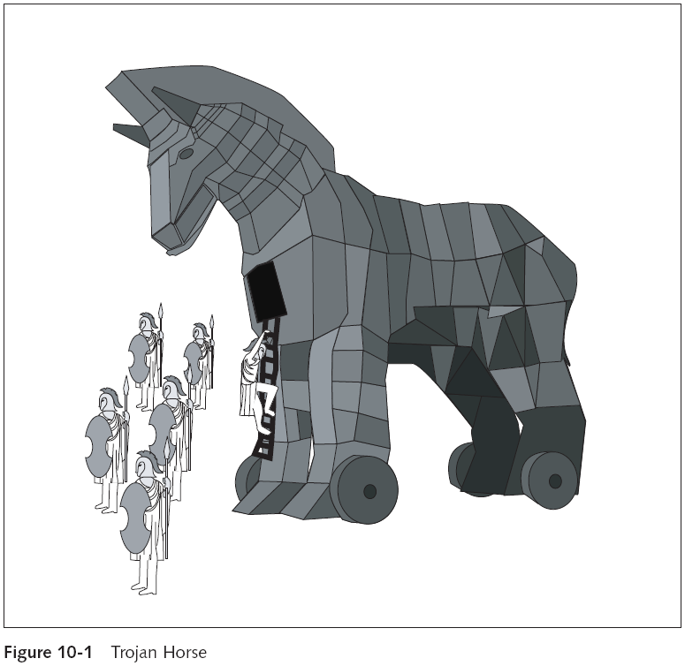
Computer Security and Penetration Testing

Slide 6
Trojan Horses (continued)
Typical functions for a Trojan might include
  Logging keystrokes, taking screen captures, accessing files on local and shared drives, or acting as a server where the client is the hacker
Trojan horse applications are usually masqueraded as games, utilities, or other useful applications
At this time, Trojans are not able to reproduce themselves like viruses or worms
Computer Security and Penetration Testing

Slide 7
Workings of Trojans
For Trojans to be a threat
  They must be installed by the user and activated
Computer Security and Penetration Testing

Slide 8
Installation
Distribution vectors:
  E-mail attachments
  Scripts in HTML e-mails
  Files on FTP servers
  Scripts on spoofed Web sites
  Scripts on hacked legitimate Web sites
  Download opportunities on Web sites
  Files offered on bulletin boards and forums
  Social engineering
Computer Security and Penetration Testing

Slide 9
Installation (continued)
Recent Trojan attacks have come disguised as a patch or package
Always validate the checksum that legitimate download sites provide
Computer Security and Penetration Testing

Slide 10
Functions of a Trojan
BO2K is a Trojan horse designed and used to make a horde of zombies
  To do the hacker’s bidding
Zombies are machines that have been unobtrusively “owned” by a hacker
When a machine is 0wned, the hacker can back door into it at any time
  And perform actions from that machine as if she were sitting at its keyboard
Computer Security and Penetration Testing

Slide 11
Functions of a Trojan (continued)
Tasks performed by Trojans include:
  Sending and receiving files
  Viewing cached passwords
  Restarting the system
  Launching processes
  Modifying files
  Sharing files
  Modifying the registry keys
Computer Security and Penetration Testing

Slide 12
Famous Trojans
This section describes the following Trojans:
  PC-Write
  AIDS
  Back Orifice
  Pretty Park
  NetBus, SubSeven
  BO2K
Computer Security and Penetration Testing

Slide 13
PC-Write (1986)
First known Trojan horse
Masqueraded as version 2.72 of the shareware word processor PC-Write by Quicksoft
Wiped out the user’s FAT (file allocation table) and formatted the hard drive
Was really a simple batch-file command, encoded as a binary .exe file
Computer Security and Penetration Testing

Slide 14
AIDS.exe/PC Cyborg (1989)
Distributed through the postal mail in 1989
Allegedly contained information about AIDS and HIV
Actual payload was aids.exe, which would encrypt the hard drive
  Prompted the user to pay a fee for the password needed to decrypt the hard drive
Computer Security and Penetration Testing

Slide 15
Back Orifice (1998)
A remote administration server
  Allows system administrators to control a computer from a remote location
Designed by a group called the Cult of the Dead Cow
Once installed, the server is intentionally difficult to detect
  And it allows almost complete control over your computer by the remote attacker
Computer Security and Penetration Testing

Slide 16
Pretty Park (1999)
The first Trojan to use a worm to propagate itself
Once installed, this application would attempt to mail itself to anyone in your address book
When PrettyPark.exe is executed, it may display the 3D pipe screen saver
  And tries to connect to an IRC server and join a specific IRC channel
Computer Security and Penetration Testing

Slide 17
Pretty Park (1999) (continued)
Pretty Park sends information to a pre-specified IRC every 30 seconds
  Author or distributor of the worm can access information on your system
Computer Security and Penetration Testing

Slide 18
NetBus (2001)
Written by Carl-Frederik Neikter
Allows anyone running the client portion (the attacker) to connect
  And control the server portion of the target computer
  Using the same rights and privileges of the current user
Computer Security and Penetration Testing

Slide 19
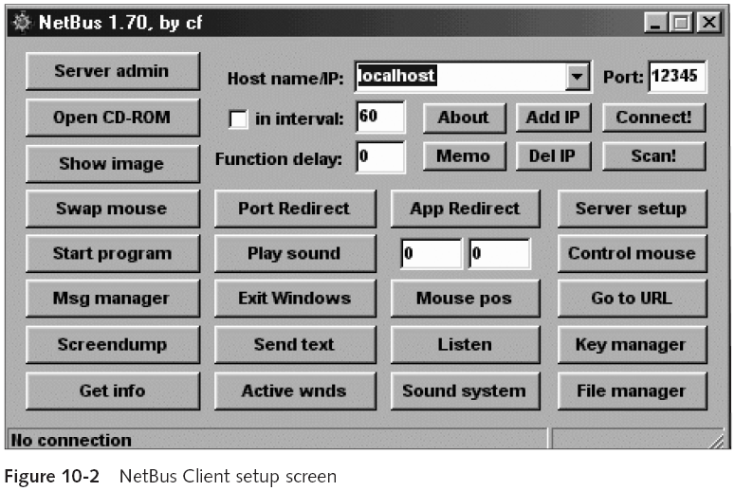
NetBus (2001) (continued)
Computer Security and Penetration Testing

Slide 20
SubSeven (1999)
Enables unauthorized people to access your computer over the Internet without your knowledge
Used a forged e-mail from Symantec to propagate itself
Computer Security and Penetration Testing

Slide 21
BO2K
Possibly “gone legitimate” as an open source project
Back Office 2000 is an interesting combination of fair and foul
  And is appealing as a concept for a network administrator with at-risk remote users
BO2K software allows you to use infected machines like a string of proxy servers
Lets you set notifiers on the infected machines
  Any client that wants to can log into your infected box
Computer Security and Penetration Testing

Slide 22
Detection and Prevention of Trojans
The best way to deal with Trojans is to never get one
  Never open an unverified executable file
  Never accept attachments that are not expected
  Never allow anybody on your network to operate with root or administrator privileges
  Make sure the standard user does not have permission to load or install programs
  Install a software firewall
Computer Security and Penetration Testing

Slide 23
Detection and Prevention of Trojans (continued)
Object reconciliation
  A widely used method that detects Trojans
  Means “verification that things are the same”
Can perform any or all of the following checks
  Date and time
  Size
  Checksum
Computer Security and Penetration Testing

Slide 24
Detection and Prevention of Trojans (continued)
Other methods for detecting Trojans
  Compare your system binaries to the original install files from your installation media
  Check the backup files for Trojan programs
  Use the Message-Digest algorithm 5 (MD5), Tripwire, and other cryptographic checksum tools
  Check for unauthorized services
  Check and examine legitimate services that you have commented out with # in /etc/inetd.conf or /etc/xinetd.conf
Computer Security and Penetration Testing

Slide 25
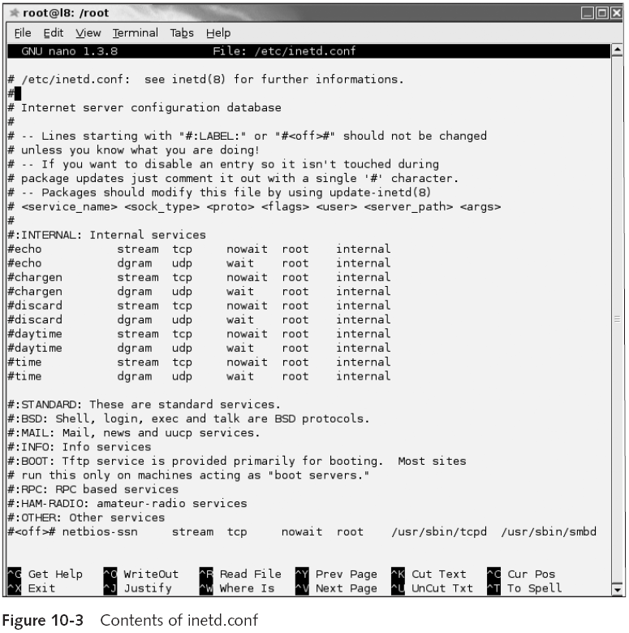
Computer Security and Penetration Testing

Slide 26
Detection and Prevention of Trojans (continued)
Common programs for detecting Trojans
  See Table 10-1
Computer Security and Penetration Testing

Slide 27
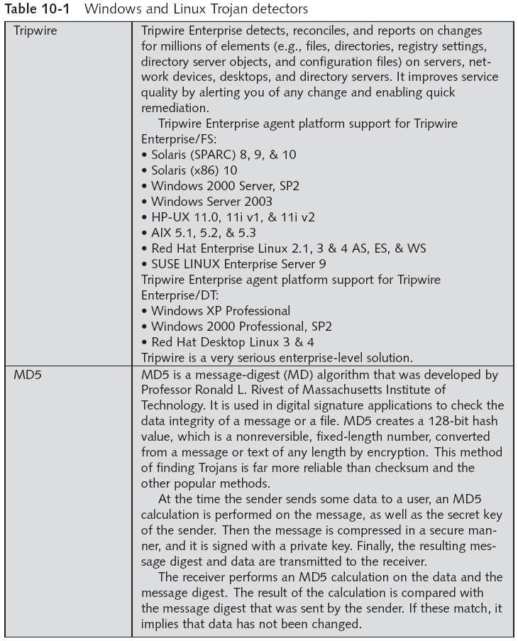
Computer Security and Penetration Testing

Slide 28
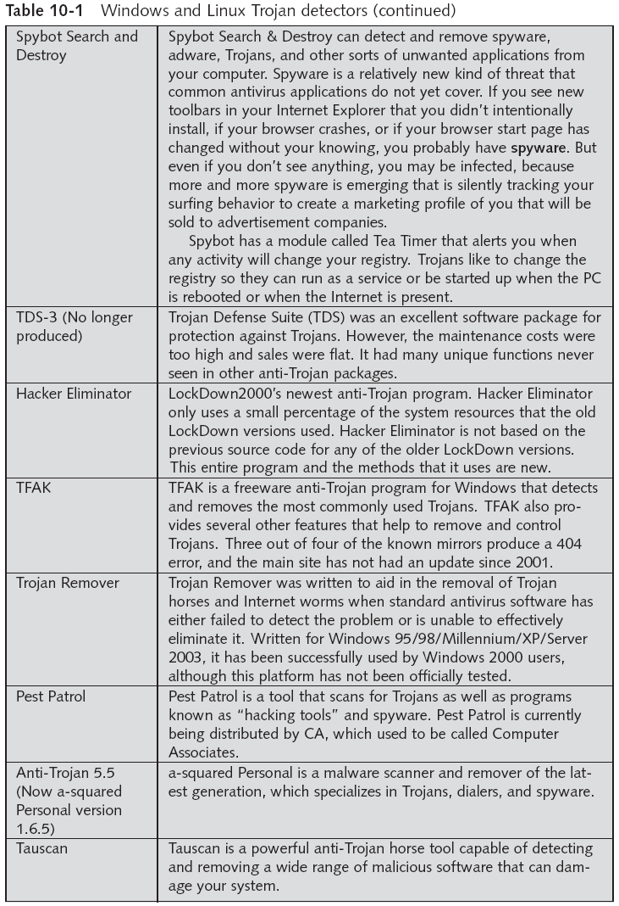
Computer Security and Penetration Testing

Slide 29
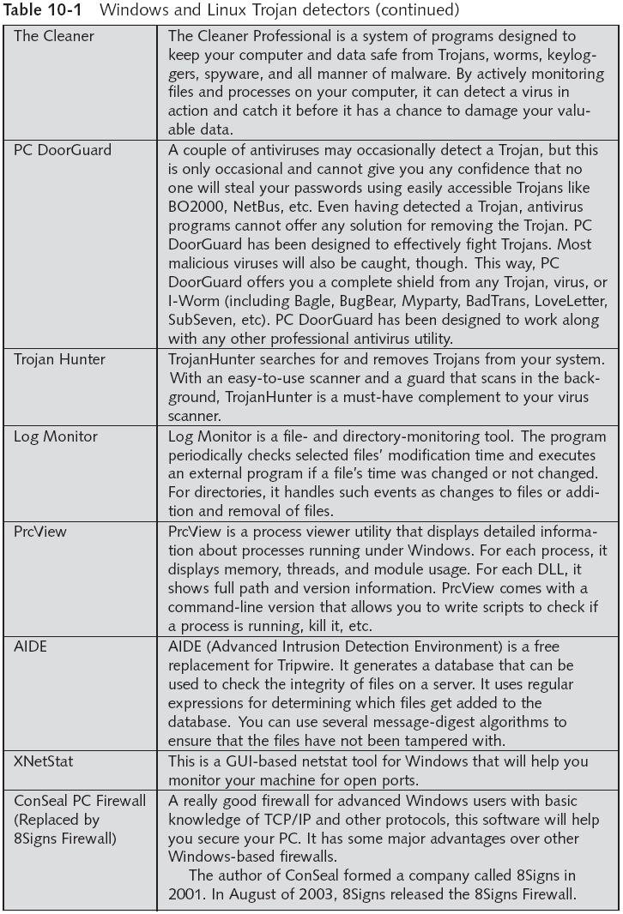
Computer Security and Penetration Testing

Slide 30
Detection and Prevention of Trojans (continued)
Basic rule
  Never open a file if you do not know what file type it is
Common (mostly safe) file types
  Graphic image formats: .jpeg, .jif, .bmp, .gif, .png, .tif
  Text file formats: .txt, .doc, and .rtf
Executable file formats
  You should not open or run unless you know the sender and know that he or she is sending you a file
Computer Security and Penetration Testing

Slide 31
Summary
Trojan horses use trickery to entice the user to install them
To be a threat, Trojans must be installed by the user and activated
Trojans act as remote administrative tools, and can be written to perform almost any task that a legitimate user can perform
There are several distribution vectors in common use, including e-mail attachments
Computer Security and Penetration Testing

Slide 32
Summary (continued)
Trojans can have many functions, such as logging keystrokes, taking screen captures, accessing files on local and shared drives, acting as a server, sending and receiving files, viewing cached passwords, restarting the system, launching processes, modifying and sharing files, and modifying registry keys
The first known Trojan horse was a fake version of PC-Write, developed in 1986
Computer Security and Penetration Testing

Slide 33
Summary (continued)
Famous Trojans include PC-Write, AIDS, Back Orifice, Pretty Park, NetBus, SubSeven, and BO2K
To prevent receiving a Trojan, never open an executable file that you have not verified
  Or open unexpected attachments
Trojans can be detected by various means, including software firewalls, IDS systems, some antivirus software, commercial programs, object reconciliation, and registry checkers
Computer Security and Penetration Testing

